Slide 1
ParallelISM AND CONCURRENCY IN Computer

Slide 2
Introduction
The coding of a parallel program for a given algorithm is strongly influenced by the parallel computing system (hardware and software components) to be used.
The software aspects include the specific operating system, the programming language and the compiler, or the runtime libraries.

Slide 3
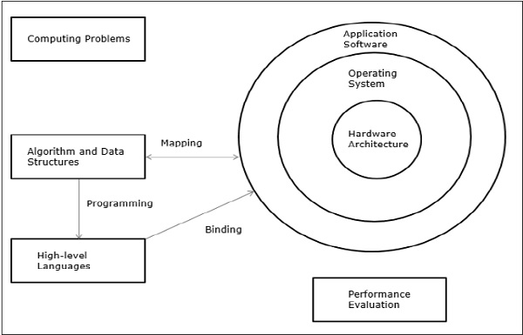
Elements of Modern Computers

Slide 4
Models for Parallel Systems
Models for parallel processing can differ in their level of abstraction.
The four basic types are
machine models
architectural models
computational models
programming models

Slide 5
Machine Model
The machine model is at the lowest level of abstraction
Consists of a description of hardware and operating system, e.g., the registers or the input and output buffers.
Assembly languages are based on this level of models.

Slide 6
Architectural Models
Architectural models are at the next level of abstraction.
Properties described at this level include the interconnection network of parallel platforms, the memory of single instructions by SIMD or MIMD etc.

Slide 7
Computational Model
The computational model is at the next higher level of abstraction.
It offers an abstract or more formal model of a corresponding architectural model.
It provides cost functions reflecting the time needed for the execution of an algorithm on the resources of a computer given by an architectural model.
E.g. a CREW (concurrent read, exclusive write) shared-memory algorithm.

Slide 8
Computational Model
A computational model provides an analytical method for designing and evaluating algorithms.
The complexity of an algorithm should reflect the performance on a real computer.
For sequential computing, the RAM model is a computational model for the von Neumann architectural model.

Slide 9
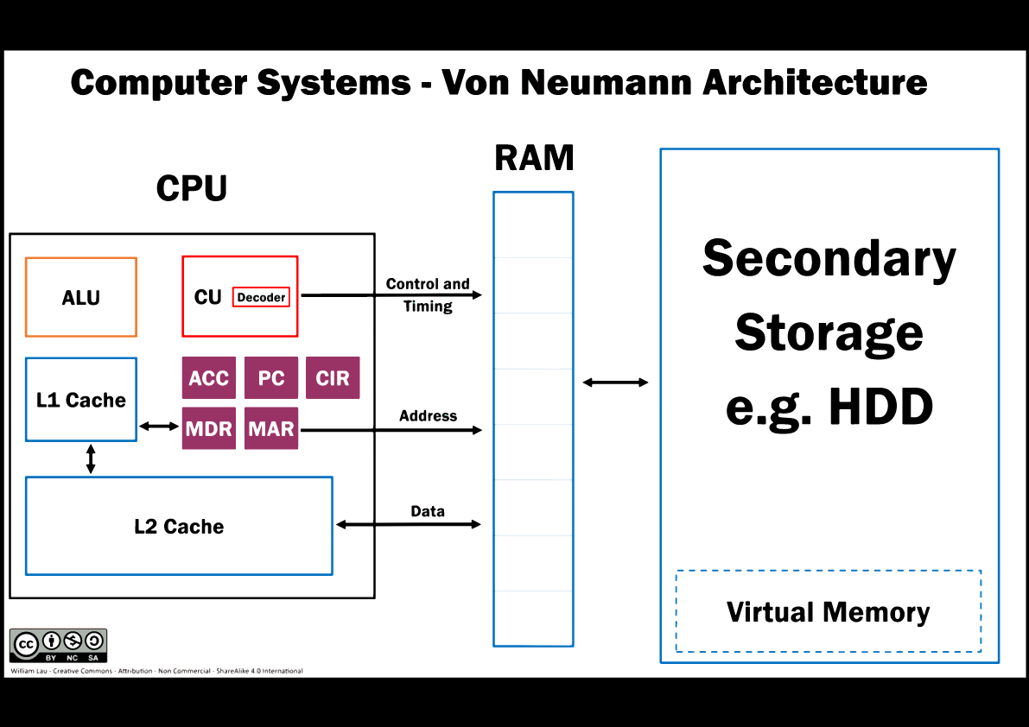
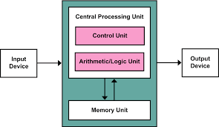
Computational Model
The RAM model is suitable for theoretical performance prediction although real computers have a much more diverse and complex architecture.

Slide 10
Computational Model
A computational model for parallel processing is the PRAM model (parallel random access machine),which is a generalization of the RAM model.

Slide 11
Programming Model
The programming model is at the next higher level of abstraction.
It describes a parallel computing system in terms of the semantics of the programming language or programming environment.
A parallel programming model specifies the programmers view on the parallel computer by defining how the programmer can code an algorithm.

Slide 12
Programming Model
This view is influenced by the architectural design and the language, compiler, or the runtime libraries, and, thus, there exist many different parallel programming models even for the same architecture.

Slide 13
Microprocessor Architecture for Parallelism
Parallelism at bit level
Parallelism by pipelining – fetch, decode, execute, write back
Parallelism by multiple functional units (ALU, FPU, etc.)
Parallelism at process or thread level

Slide 14
Bit-level Parallelism
By increasing processor word size to reduce the number of instructions the processor must execute to perform an operation on variables whose sizes are greater than the length of the word.
Adding two 16-bit integers on a 8-bit processor.
The processor must first add the 8 lower-order bits from each integer, then add the 8 higher-order bits.
Two instructions needed to complete a single operation.
A 16-bit processor would be able to complete the operation with a single instruction.

Slide 15
Parallelism by Pipelining
Instruction-level parallelism within a single processor.
Keep every part of the processor busy with some instruction.
Divide incoming instructions into a series of sequential steps (pipeline).
Different processor units process different parts of instructions in parallel.

Slide 16
Parallelism by Pipelining
In von Neumann cycle, an instruction may comprise:
Fetch the instruction
Fetch the operands
Do the instruction
Write the results.
A pipelined computer usually has "pipeline registers" after each stage to store information from the instruction and calculations so that the logic gates of the next stage can do the next step.

Slide 17
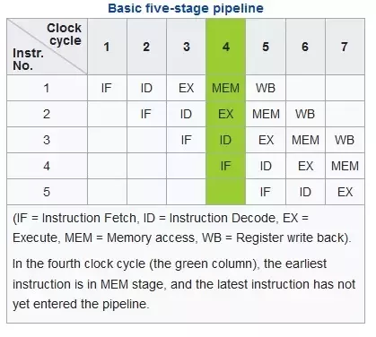
Parallelism by Pipelining
How many clock cycles are needed with/without instruction pipelining on a classic RISC pipeline to execute 5 instructions?

Slide 18
Parallelism by Multiple Functional Units
Cores usually have multiple functional units to perform multiple arithmetic operations in parallel.
Done implicitly by superscalar execution of serial instructions or hardware multithreading; or
By explicit vector instructions.
A single-core design may use all three.
Notes:
A superscalar processor allows multiple unrelated instructions to start on the same clock cycle on separate hardware units or pipelines.

Slide 19
Parallelism at Process or Thread Level
Each processor executes a different thread (or process) on the same or different data.
The threads may execute the same or different code.
Usually different execution threads communicate with one another as they work

Slide 20
Parallelism at Process or Thread Level
Thread-level parallelism (TLP) is found largely in applications written for commercial servers such as databases.
Running many threads at once to tolerate the high amounts of I/O and memory system latency
While a thread is delayed waiting for a memory or disk access, other threads can do useful work.

Slide 21
Parallelism at Process or Thread Level
Multi-core microprocessors further enables multithreading in the desktop market.
New applications will have to be designed to utilize multiple threads in order to benefit from the increase in potential computing power.

Slide 22
Flynn’s Taxonomy of Parallel Architecture
Single instruction, single data (SISD)
Multiple instruction, single data (MISD)
Single instruction, multiple data (SIMD)
Multiple instruction, multiple data (MIMD)
 | 1 instruction flow | > 1 instruction flow
1 data stream | SISD (Von Neumann) | MISD (Pipeline)
> 1 data stream | SIMD (GPU computing) | MIMD (Distributed/Multi-core)
Notes:
Michael J. Flynn (1966)

Slide 23
Single Instruction, Single data (SISD)
One CPU containing a single arithmetic-logic unit capable of only scalar arithmetic.
May have more than one functional unit, but all functional units are controlled by a single control unit.

Slide 24
Multiple Instruction, Single Data (MISD)
n processor units each receiving distinct instruction operating over the same data stream.
An uncommon architecture generally used for fault tolerance.
Heterogeneous systems operate on the same data stream and must agree on the result.
Examples include the Space Shuttle flight control computer.

Slide 25
Single Instruction, Multiple Data (SIMD)
Multiple processing units and one control unit. All processing units received the same instruction from the control unit but operate on different data sets from distinct data streams.
Instructions can be executed sequentially, such as by pipelining, or in parallel by multiple functional units.

Slide 26
Multiple Instruction, Multiple Data (MIMD)
More than one processor unit having the ability to execute several programs simultaneously.
Include multi-core superscalar processors, and distributed systems, using either one shared memory space or a distributed memory space.

Slide 27
SOME ISSUES & Challenges of PARALLEISM

Slide 28
Amdahl's Law
Amdahl's Law is a law governing the speedup of using parallel processors on a problem, versus using only one serial processor.
The speed of a program is the time it takes the program to execute.
Speedup S(n) is defined as the time it takes a program to execute in serial (with one processor) divided by the time it takes to execute in parallel (with many processors).
Let the function T (n) represent the time a program takes to execute with n processors. The speedup computed by Amdahl’s law is a comparison between T (1), the time on a uniprocessor, and T (n), the time on a multiprocessor with n processors.
S(n) =T(1) / T(n)

Slide 29
If we know what fraction of T(1) is spent computing parallelizable code, we can determine T(n) in terms of T(1).
If p is the parallel fraction of T(1), then it takes p.T(1) units of time to run the parallel part and (1-p).T(1) units of time to run the sequential part.
Dividing the parallel time across all n processors, we form T(n) = T(1)(1 - p) + T(1)p/n.
Substituting into S(n) = T(1) / T(n)
S(n) = T(1) / (T(1)(1-p) + T(1)p/n)
S(n) <= 1/((1-p) + p/n)
Lim(n->∞) S(n) = 1/(1-p)

Slide 30
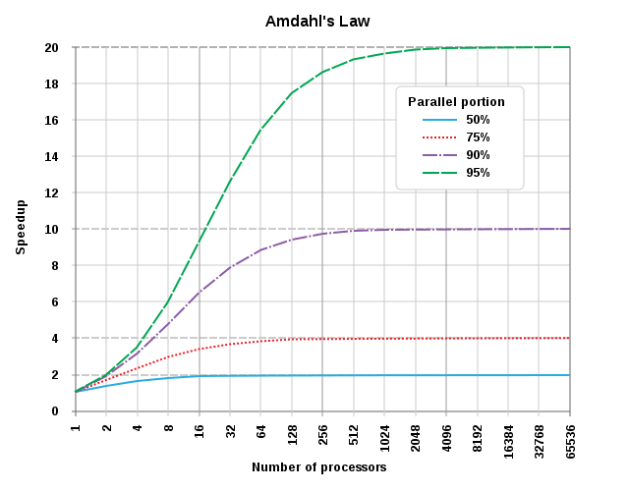
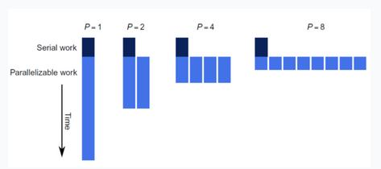

Slide 31
Questions
If 30% of the execution time may be parellized, and the improvement makes the affected part twice as fast, what will be the speedup?
Given a serial task which is split into four consecutive parts, whose percentages of execution time are p1 = 0.11, p2 = 0.18, p3 = 0.23, and p4 = 0.48 respectively. Then we are told that the 1st part is not sped up, while the 2nd part is sped up 5 times, the 3rd part is sped up 20 times, and the 4th part is sped up 1.6 time. What is the overall speedup?

Slide 32
Gustafson’s Law
Amdahl’s point of view is focused on a fixed computation problem size.
Gustafson's objection is that massively parallel machines allow computations on very large data sets in fixed amount of time.
A parallel platform does more than speeding up the execution of a code: it enables dealing with larger problems.
This law says that increase of problem size for large machines can retain scalability with respect to the number of processors.
Assume that the workload is scaled up on an n-node machine as,
W’ = aW + (1-a)nW
Sequential + Parallel workload

Slide 33
Gustafson’s Law
Speedup for the scaled up workload is then
S = Single processor execution time / n-processor execution time
= (aW + (1-a)nW) / (aW/1 + (1-a)nW/n)
= a + (1-a)n
What Gustafson’s law says is that the true parallel power of a large multiprocessor system is only achievable when a large parallel problem is applied.

Slide 34
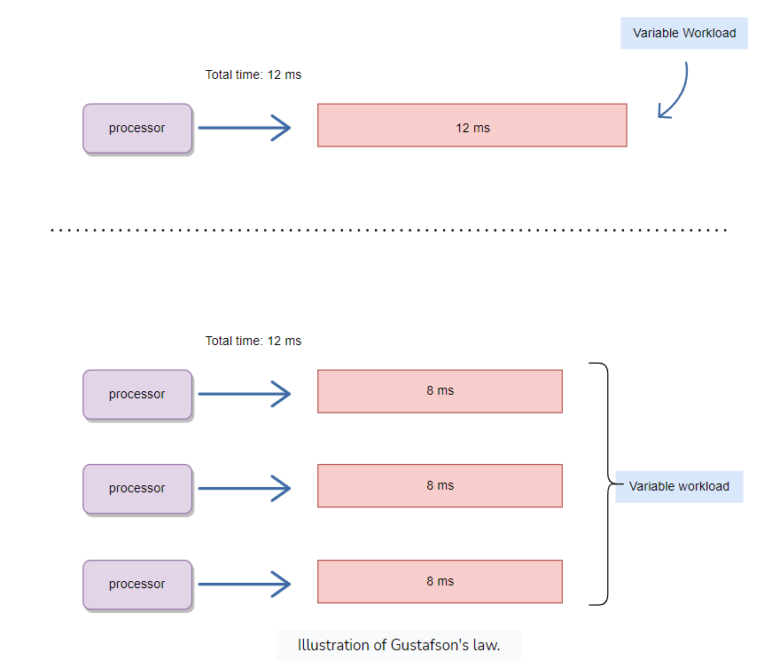
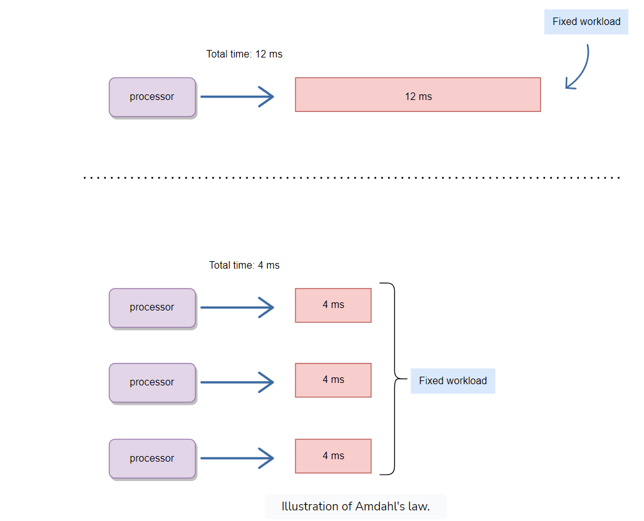
Amdahl’s Law vs Gustafson’s Law

Slide 35
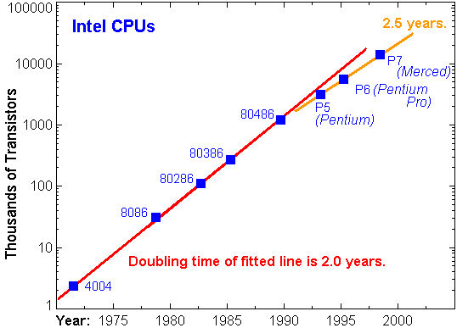
Moore’s Law
The number of transistors per square inch on integrated circuits had doubled every year since their invention. The trend will continue into the foreseeable future.
~Intel co-founder Gordon Moore in “Cramming More Components onto Integrated Circuits”, Electronics Magazine 19 April 1965

Slide 36
Free Lunch is Over
The Free Lunch Is Over: A Fundamental Turn toward Concurrency in Software
Herb Sutter, 2005
Clock speed race is over
Heat
Power consumption
Current leakage
Performance gains are going to be accomplished in
Hyper threading
Multi-core
Cache

Slide 37
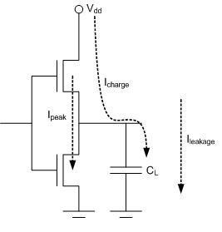
Clock Speed vs Power Consumption
The fundamental building blocks of any microprocessor are gates.
Gates are collections of transistors that electrically mimic a particular logic function.
W = CV²
Power = WF = CV²F
Notes:
W=Energy
C=Capacitance
V=Voltage
F= Force

Slide 38
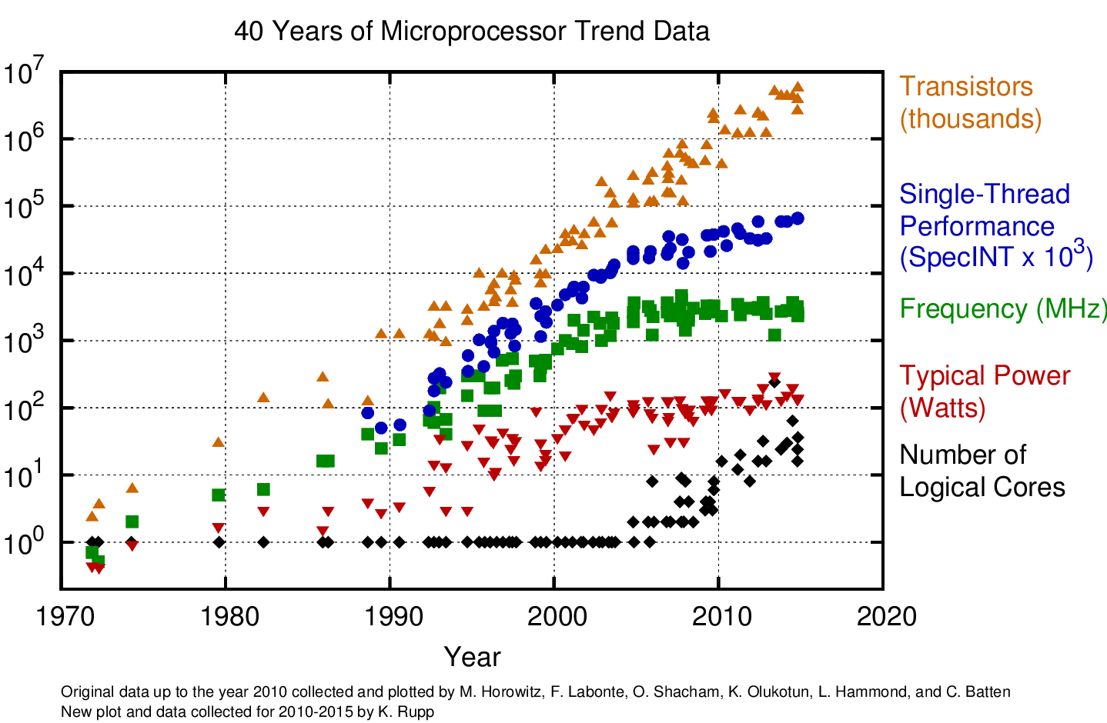
Single vs Dual Processors
Single processor: Power = CV²F
Dual processors each with F’ = F/2; C’ = 2.2C; V’ = 0.6V; Power =?

Slide 39
Dual Processor = Twice Faster than Single Processor？
Two processors share resources, such as L2 and L3 caches, busses, and system memory.
Bottlenecks that slow down the overall performance.
Programs must be written to take advantage of multiprocessing.
The performance is dependent on how the application is written.
Faster than single processor machines, but rarely twice as fast.

Slide 40
Dual Processor vs Dual Core
A dual processor computer has two physically separated CPUs on the motherboard.
May share resources (e.g. CPU bus and cache)
In a dual-core system, the two processors are combined into a single chip that may look like one processor.
Some systems have two dual-core CPUs, totally four processing cores, and so on.

